Slide 1
Software Engineering I
Dr. Elham Mahmoudzadeh
Isfahan University of Technology
mahmoudzadeh@iut.ac.ir
2021

Slide 2
Chapter 10 Human–Computer Interaction Layer Design(I)

Slide 3
Steps(I)
Preparing proposal
Requirements determination
User story
Abstract Business Process Modelling
Analysis
Functional Modelling
Structural Modelling
Behavioral Modelling

Slide 4
Steps(II)
Design
Optimization
Database Management
User Interface
Physical Architecture

Slide 5
Introduction
A user interface is the part of the system with which the users interact.
From the user’s point of view, the user interface is the system.
It includes the screen displays that provide navigation through the system, the screens and forms that capture data, and the reports that the system produces (whether on paper, on the screen, or via some other medium).

Slide 6
Introduction(Cnt’d)
Interface design is the process of defining how a system will interact with external entities (e.g., customers, suppliers, other systems).
Focus on the design of user interfaces, but it is also important to remember that there are sometimes system interfaces, which exchange information with other systems.
System interfaces are typically designed as part of a systems integration effort. They are defined in general terms as part of the physical architecture and data management layers.
The human–computer interaction layer defines the way in which the users interact with the system and the nature of the inputs and outputs that the system accepts and produces.

Slide 7
From the user’s point of view, the user interface on the human–computer interaction layer is the system.
Users do not really care about how the problem domain objects are stored. But, they do care about how they can use the system to support them in their activities.
Based on our layered based design approach, the user interface of the human–computer interaction layer is independent of the data management layer. But it is dependent on both the problem domain and physical architecture layers.

Slide 8
Three fundamental parts of GUI
Even though there are command-line user interfaces, we are only focusing on graphical user interfaces (GUI).
Regardless of the underlying hardware being used, a GUI-based user interface comprises three fundamental parts.
Navigation mechanism, the way in which the user gives instructions to the system and tells it what to do (e.g., buttons, menus).
Input mechanism, the way in which the system captures information (e.g., forms for adding new customers).
Output mechanism, the way in which the system provides information to the user or to other systems
Each of these is conceptually different, but they are closely intertwined and must designed incrementally and iteratively.

Slide 9
Principles for User Interface Design
In many ways, user interface design is an art. The goal is to make the interface pleasing to the eye and simple to use while minimizing the effort the users need to accomplish their work.
We have found that the greatest problem facing experienced designers is using space effectively.
There is much more information that needs to be presented on a screen or report or form than will fit comfortably.
Analysts must balance the need for simplicity and pleasant appearance against the need to present the information across multiple pages or screens, which decreases simplicity.

Slide 10
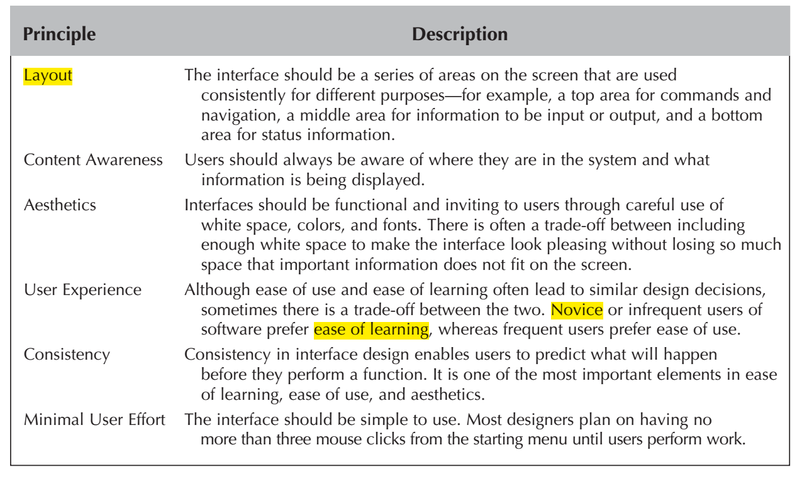
Some Fundamental Interface Design Principles

Slide 11
Layout
Screen is divided into three boxes.
The top box is the navigation area, through which the user issues commands to navigate through the system.
The bottom box is the status area, which displays information about what the user is doing.
The middle—and largest—box is used to display reports and present forms for data entry.
This use of multiple layout areas also applies to inputs and outputs. Data areas on reports and forms are often subdivided into subareas, each of which is used for a different type of information. These areas are almost always rectangular, although sometimes space constraints require odd shapes. Nonetheless, the margins on the edges of the screen should be consistent. Each of the areas within the report or form is designed to hold different information.
Each area is self-contained so that information in one area does not run into another. The areas and information within areas should have a natural intuitive flow to minimize the users’ movement from one area to the next.

Slide 12
Layout(Cnt’d)
People in Westernized nations tend to read left-to-right, top-to-bottom, so related information should be placed so that it is used in this order. Sometimes the sequence is in chronological order, or from the general to the specific, or from most frequently to least frequently used.
The flow between sections should also be consistent, whether horizontal or vertical.
Ideally, the areas will remain consistent in size, shape, and placement for the forms used to enter information (whether paper or on screen) and the reports used to present it.

Slide 13
Content Awareness
Refers to the ability of an interface to make the user aware of the information it contains with the least amount of effort on the user’s part.
All parts of the interface, whether navigation, input, or output, should provide as much content awareness as possible.
All interfaces should have titles. Menus should show where the user is and, if possible, where the user came from to get there.

Slide 14
Content Awareness(Cnt’d)
Content awareness also applies to the areas within forms and reports. All areas should be clear and well-defined so that it is difficult for the user to become confused about the information in any area. Then users can quickly locate the part of the form or report that is likely to contain the information they need.
Sometimes the areas are marked by lines, colors, or headings;
Content awareness also applies to the fields within each area. Fields are the individual elements of data that are input or output.
The field labels that identify the fields on the interface should be short and specific—objectives that often conflict.
There should be no uncertainty about the format of information within fields, whether for entry or display. For example, a date of 10/5/15 is different depending on whether you are in the United States (October 5, 2015) or in Canada (May 10, 2015).
Any fields for which there is the possibility of uncertainty or multiple interpretations should provide explicit explanations.

Slide 15
Content Awareness(Cnt’d)
Content awareness also applies to the information that a form or report contains.
In general, all forms and reports should contain a preparation date (i.e., the date printed or the date completed) so that the age of information is obvious.
Likewise, all printed forms and software should provide version numbers so that users, analysts, and programmers can identify outdated materials.

Slide 16
Aesthetics
Refers to designing interfaces that are pleasing to the eye.
Interfaces do not have to be works of art, but they do need to be functional and inviting to use. In most cases, less is more, meaning that a simple, minimalist design is the best.
Space is usually at a premium on forms and reports, and often there is the temptation to squeeze as much information as possible onto a page or a screen. Unfortunately, this can make a form or report so unpleasant that users do not want to use it.
In general, all forms and reports need a minimum amount of white space that is intentionally left blank.

Slide 17
Aesthetics(Cnt’d)
The design of text is equally important. As a general rule, all text should be in the same font and about the same size.
Fonts should be no smaller than 8 points, but 10 points is often preferred, particularly if the interface will be used by older people.
Changes in font and size are used to indicate changes in the type of information that is presented (e.g., headings, status indicators).
In general, italics and underlining should be avoided because they make text harder to read.
Serif fonts (i.e., those having letters with serifs, or tails, such as Times Roman) are the most readable for printed reports, particularly for small letters.
Never use all capital letters, except possibly for titles.

Slide 18
Aesthetics(Cnt’d)
Color and patterns should be used carefully and sparingly and only when they serve a purpose.
Goal is pleasant readability, not art; color and patterns should be used to strengthen the message, not overwhelm it.
Color is best used to separate and categorize items, such as showing the difference between headings and regular text, or to highlight important information. Therefore, colors with high contrast should be used (e.g., black and white).
In general, black text on a white background is the most readable, and blue on red is the least readable.
When it comes to the proper use of color, cultural issues come into play.

Slide 19
User Experience
User experience can essentially be broken down into two levels: those with experience and those without.
Interfaces should be designed for both types of users.
Novice users usually are most concerned with ease of learning—how quickly they can learn new systems.
Expert users are usually most concerned with ease of use—how quickly they can use the system once they have learned how to use it.
Often these two are complementary and lead to similar design decisions, but sometimes there are trade-off s. Novices, for example, often prefer menus that show all available system functions, because these promote ease of learning. Experts, on the other hand, sometimes prefer fewer menus organized around the most commonly used functions.

Slide 20
User Experience(Cnt’d)
The balance of quick access to commonly used and well-known functions and guidance through new and less-well-known functions is challenging to the interface designer, and this balance often requires elegant solutions.

Slide 21
Consistency
Consistency in design is probably the single most important factor in making a system simple to use because it enables users to predict what will happen. When interfaces are consistent, users can interact with one part of the system and then know how to interact with the rest, aside from elements unique to those parts.
Ideally, the system should also be consistent with other computer systems in the organization.
Consistency occurs at many different levels. Consistency in the navigation controls conveys how actions in the system should be performed.
Consistency in terminology is also important. This refers to using the same words for elements on forms and reports.

Slide 22
Consistency(Cnt’d)
Consistency in report and form design is important, although a study suggests that being too consistent can cause problems.
When reports and forms are very similar except for very minor changes in titles, users sometimes mistakenly use the wrong form and either enter incorrect data or misinterpret its information.
The implication for design is to make the reports and forms similar but give them some distinctive elements (e.g., color, size of titles) that enable users to immediately detect differences.

Slide 23
Minimizing User Effort
Interfaces should be designed to minimize the amount of effort needed to accomplish tasks.
This means using the fewest possible mouse clicks or keystrokes to move from one part of the system to another.
Most interface designers follow the three-clicks rule: Users should be able to go from the start or main menu of a system to the information or action they want in no more than three mouse clicks or three keystrokes.

Slide 24
Krug’s principles
Don’t make me think
Minimize user’s efforts
Minimize the number of words on the screen

Slide 25
1- Don’t make me think
First, the user should never have to think about how to navigate the user interface.
Any time the user has to stop and figure out how to use the user interface, the creator of the user interface has failed.
From a practical perspective, we should study how the user really uses the system.
Based on Krug’s observations of users, he found that users do not read Web pages; instead, they tend to scan them.
Make it easy for users to identify the different parts of the user interface so that they simply scan the screen to see the section of the interface that is applicable to the problem that they are solving.
Given the user’s tendency to simply scan the user interface, Krug suggests that we should consider studying billboards for inspiration. Billboards are designed to be “read” at 70 mph as you drive down the highway. Obviously, the most relevant information must catch your attention for the billboard advertisement to work.
He suggests that we should use the set of conventions with which we are familiar. Look for conventions that we can employ to aid the user.

Slide 26
2- Minimize user’s efforts
Important thing is to design the user interface such that the choices (clicks) to be made are unambiguous.
Making a lot of obvious choices is a lot quicker and easier than a few vague and ambiguous ones.
The goal is to minimize the user’s effort. Simply focus on making it easier for the user to complete the task.

Slide 27
3- Minimize the number of words on the screen
Given that users scan the screen to find for what they are searching, make it easier by not cluttering the screen with lots of noise.
He suggests that in the case of Web interfaces, 50 percent to 75 percent of the words can be eliminated without losing any information contained on the screen.

Slide 28
Three golden rules
Place the user in control.
Reduce the user’s memory load.
Make the interface consistent

Slide 29
1- Place the User in Control
“What I really would like, is a system that reads my mind. It knows what I want to do before I need to do it and makes it very easy for me to get it done. That’s all, just that.”
She wanted to control the computer, not have the computer control her.
Define interaction modes in a way that does not force a user into unnecessary or undesired actions
Provide for flexible interaction
Allow user interaction to be interruptible and undoable
Streamline interaction as skill levels advance and allow the interaction to be customized
Hide technical internals from the casual user
Design for direct interaction with objects that appear on the screen

Slide 30
2- Reduce the User’s Memory Load
The more a user has to remember, the more error-prone the interaction will be. Whenever possible, the system should “remember” pertinent information and assist the user with an interaction scenario that assists recall.
Reduce demand on short-term memory
Establish meaningful defaults
Define shortcuts that are intuitive
The visual layout of the interface should be based on a real-world metaphor
Disclose information in a progressive fashion

Slide 31
3- Make the Interface Consistent
The interface should present and acquire information in a consistent fashion.

Slide 32
User Interface Design Process
User interface design is a use-case driven, incremental, and iterative process.
Analysts often move back and forth between the different parts (navigation, input, and output) of the user interface, rather than proceeding sequentially from one part to another part. Given that the design process is use case driven, the analysts begin the user interface design process by examining the use cases and their associated sequence diagrams. Analysts then typically set down with users to develop use scenarios that describe commonly employed patterns of actions the users will perform so that the interface enables users to quickly and smoothly perform these scenarios.
Another useful idea when developing a user interface is to have a set of accepted interface standards that can be used across multiple applications.
For example, a standard set of menus, icons, and user interface templates simplify the entire design of the human computer interaction layer.

Slide 33
Navigation Structure Design
The navigation structure defines the basic components of the interface and how they work together to provide functionality to users.
A windows navigation diagram (WND) is used to show how all the screens, forms, and reports used by the system are related and how the user moves from one to another. Most systems have several WNDs, one for each major part of the system.
A stereotype is modeled as a text item enclosed within guillemets or angle brackets (<< >>). The stereotype represents the type of user interface component of a box on the diagram.
The basic navigation structure of an interface follows the basic structure of the business process itself, as defined in the use cases and behavioral model.
The analyst starts with the essential use cases and develops the fundamental flow of control of the system, then they examines the use scenarios to see how well the WND supports them.

Slide 34
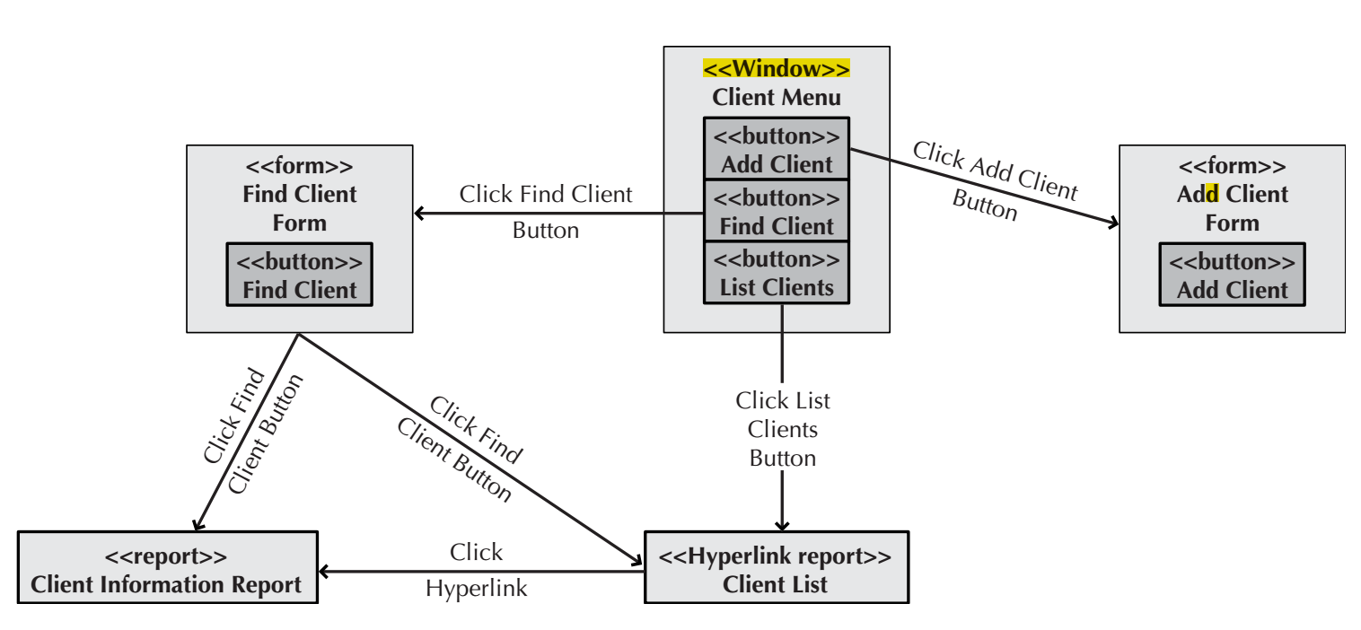
A sample of WND

Slide 35
Interface Design Prototyping
An interface design prototype is a mock-up or a simulation of a computer screen, form, or report.
A prototype is prepared for each interface in the system to show the users and the programmers how the system will perform.
The most common approaches to interface design prototyping are
Windows layout diagrams,
Storyboards,
User Interface prototypes.

Slide 36
Windows Layout Diagram
A windows layout diagram is simply a picture that resembles the actual user interface that the user will gradually receive.
Typically, it is created using a tool such as Microsoft’s Visio. Using this type of tool, the designer can quickly drag and drop the user interface components onto the canvas to lay out the design of the user interface.
Even though there is no executable capability associated with a windows layout diagram, it does allow the user to quickly get a feel for the look of the user interface that will be delivered.

Slide 37
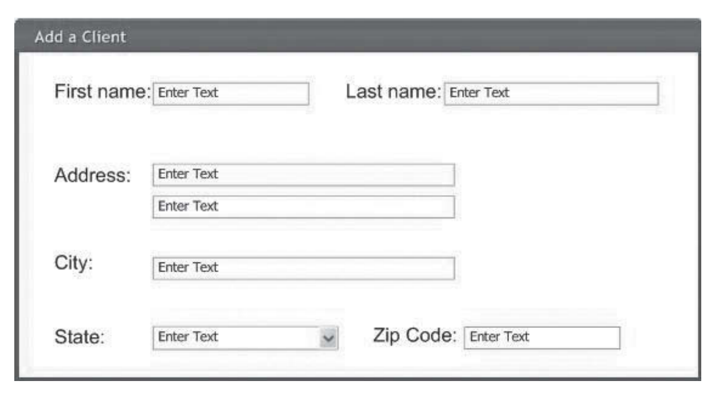
A sample of Windows Layout Diagram

Slide 38
Storyboard
At its simplest, an interface design prototype is a paper-based storyboard. The storyboard shows hand-drawn pictures of what the screens will look like and how they flow from one screen to another.
Storyboards also combine both the navigation information of the windows navigation diagram and to some degree the layout information of the windows layout diagram.

Slide 39
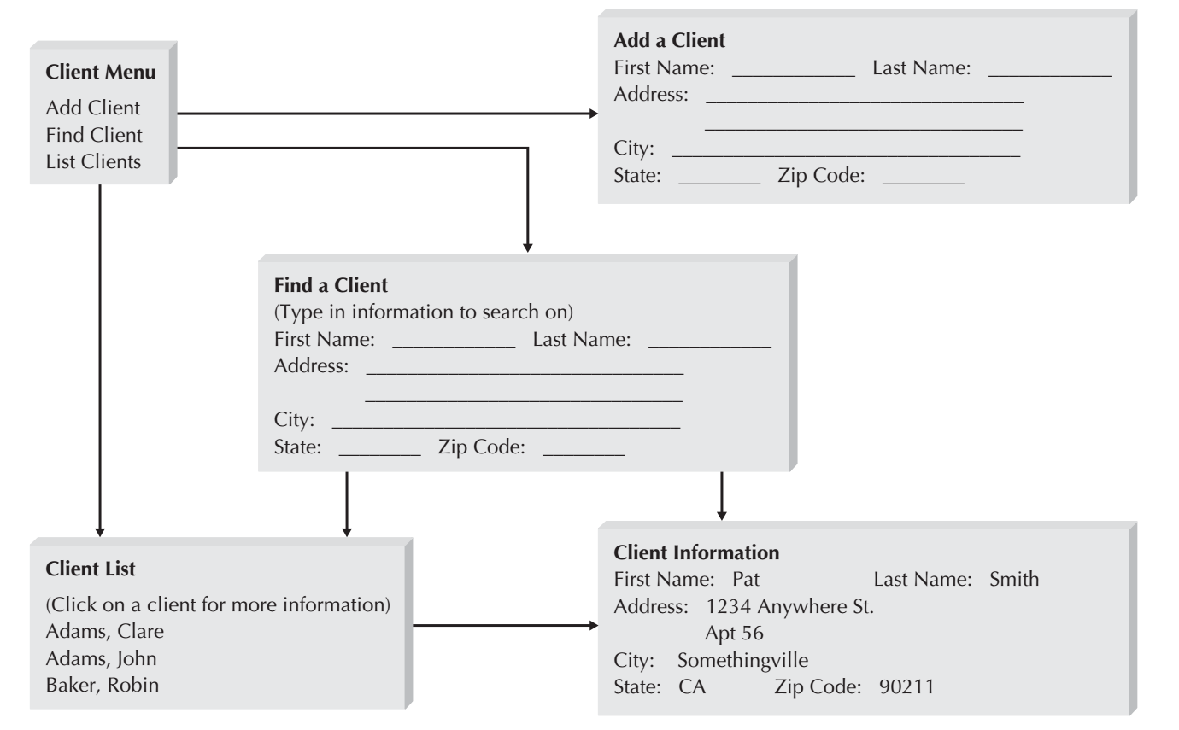
A sample of Storyboard

Slide 40
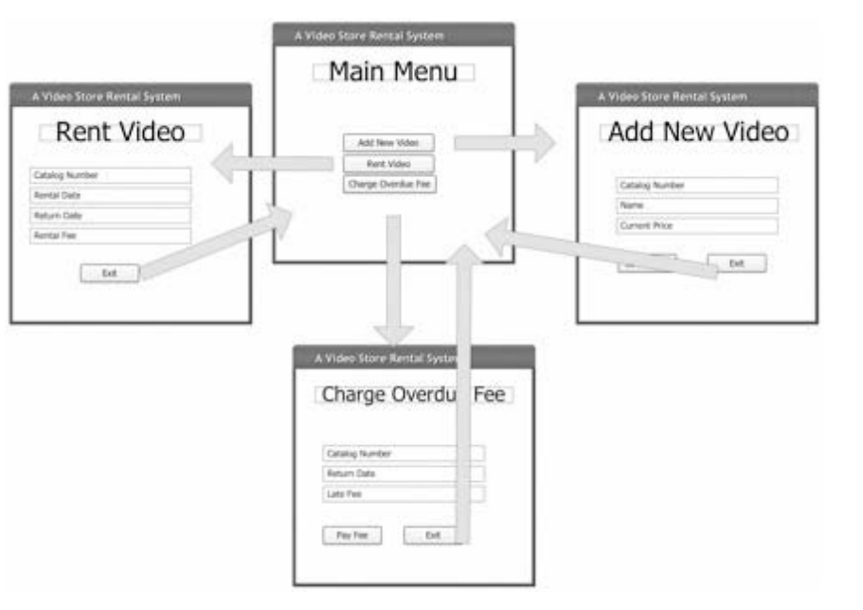
A sample of Combined Windows Navigation and Layout Diagrams

Slide 41
User Interface Prototypes
Is executable prototypes of the user interface that would allow the user to be able to interact with the user interface by clicking on buttons and entering pretend data into forms (but because there is no system behind the pages, the data are never processed).
The different parts of the user interface are linked together so that as the user clicks on buttons, the requested part of the system appears. These executable prototypes take longer to develop than windows navigation diagrams, windows layout diagrams, and storyboards but have the distinct advantage of showing exactly what the screens will look like.
The user does not have to guess about the shape or position of the elements on the screen. However, one of the potential issues that can arise when developing user interface prototypes is that the user’s expectations of when the systems will be completed can become unrealistic. To actually connect the prototype up to the problem domain such that the system actually works is not a trivial problem. So, user expectations need to be carefully managed.

Slide 42
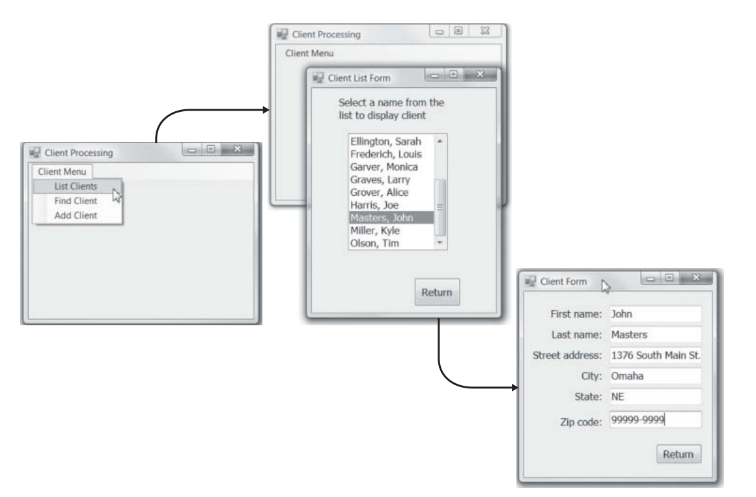
A sample of User Interface Prototype

Slide 43
Selecting the appropriate techniques
Projects often use a combination of different interface design prototyping techniques for different parts of the system.
Storyboarding is the fastest and least expensive but provides the least amount of detail.
Windows layout diagrams provide more of a feel that the user will experience, while remaining fairly inexpensive to develop.
User interface prototypes are the slowest, most expensive, and most detailed approach.
Storyboarding is used for parts of the system in which the interface is well understood and when more-expensive prototypes are thought to be unnecessary. However, in most cases it is probably worth the additional cost of developing windows layout diagrams in addition to storyboards. User interface prototypes are used for parts of the system that are critical, yet not well understood.

Slide 44
Interface Evaluation
The objective of interface evaluation is to understand how to improve the interface design before the system is complete. Most interface designers intentionally or unintentionally design an interface that meets their personal preferences, which might or might not match the preferences of the users. The key message, therefore, is to have as many people as possible evaluate the interface, and the more users the better.
Many organizations save interface evaluation for the very last step in the systems development before the system is installed. Ideally, however, interface evaluation should be performed while the system is being designed—before it is built—so that any major design problems can be identified and corrected before the time and cost of programming have been spent on a weak design.

Slide 45
Interface Evaluation(Cnt’d)
It is not uncommon for the system to undergo one or two major changes after the users see the first interface design prototype because they identify problems that are overlooked by the project team. As with interface design prototyping, interface evaluation can take many different forms, each with different costs and different amounts of detail.
Four common approaches are
Heuristic evaluation,
Walkthrough evaluation,
Interactive evaluation,
Formal usability testing

Slide 46
Heuristic Evaluation
A heuristic evaluation examines the interface by comparing it to a set of heuristics or principles for interface design. The project team develops a checklist of interface design principles.
At least three members of the project team then individually work through the interface design prototype, examining every interface to ensure that it satisfies each design principle on a formal checklist. After each has gone through the prototype separately, they meet as a team to discuss their evaluations and identify specific improvements that are required.

Slide 47
Walkthrough Evaluation
An interface design walkthrough evaluation is a meeting conducted with the users who ultimately have to operate the system.
The project team presents the prototype to the users and walks them through the various parts of the interface. The project team shows the storyboard and windows layout diagrams or actually demonstrates the user interface prototype and explains how the interface will be used. The users identify improvements to each of the interfaces that are presented.

Slide 48
Interactive Evaluation
With an interactive evaluation, the users themselves actually work with the user interface prototype in a one-person session with member(s) of the project team. As the user works with the prototype, he or she tells the project team member(s) what he or she likes and doesn’t like and what additional information or functionality is needed.
As the user interacts with the prototype, team member(s) records the cases when he or she appears to be unsure of what to do, makes mistakes, or misinterprets the meaning of an interface component. If the pattern of uncertainty, mistakes, or misinterpretations reoccurs across several of the users participating in the evaluation, it is a clear indication that those parts of the interface need improvement.

Slide 49
Formal Usability Testing
Formal usability testing is commonly done with commercial software products and products developed by large organizations that will be widely used through the organization.
As with interactive evaluation, usability testing is done in one-person sessions in which a user works directly with the software. However, it is typically done in a special lab equipped with video cameras and special software that records every keystroke and mouse operation so that they can be replayed to understand exactly what the user did. The user is given a specific set of tasks to accomplish (usually the use scenarios), and after some initial instructions, the project team’s members are not permitted to interact with the user to provide assistance. The user must work with the software without help, which can be hard on the users if they become confused with the system.
It is critical that users understand that the goal is to test the interface, not their abilities, and if they are unable to complete the task, the interface—not the user—has failed the test.
Formal usability testing is very expensive, because each one-user session can take one to two days to analyze depending on the volume of detail collected in the computer logs and videos. Sessions typically last one to two hours. Most usability testing involves five to ten users, because if there are fewer than five users, the results depend too much on the specific individual users who participated, and more than ten users are often too expensive to justify.

Slide 50
Reference
Dennis, Wixon, Tegarden, “System Analysis and Design, An Object Oriented Approach with UML”, 5th Edition, 2015.

